Slide 1

It’s Power Query M Let’s have some fun!
Cédric L. Charlier
@Seddryck

Slide 2













Sponsors help us to run this event! THX!
You Rock! Sponsor
Gold Sponsor
Silver Sponsor
Bronze Sponsor

Slide 3
You Rock! Sponsor Session
13:45 Track 1
„Das super nerdige Solisyon Film- und Serienquiz“

Slide 4
Save the date for exiting upcoming events
PASS Camp 2017 Main Camp 05.12. – 07.12.2017 (04.12. Kick-Off abends) Lufthansa Training & Conference Center, Seeheim
SQL Konferenz 2018
PreCon: 26.02.2018 MainCon: 27.02. – 28.02.2018 Darmstadtium, Darmstadt
More information at PASS booth

Slide 5


Skills & Interests
Cédric L. Charlier
@Seddryck
In a nutshell
Database architecture
Data modeling
Business intelligence
Data warehousing
ETL
Olap/Tabular
No SQL
Big data
Data analysis
Machine learning
seddryck.wordpress.com
Data & BI architect
Agile data warehouse
Quality-oriented
Automation fanboy
Open-sources contributions
Testing framework for BI
www.nbi.io
Other projects on github
Deployment SSRS – RsPackage
TmBundle for a few languages
Starting SSIS from .Net - Cassis
Toolset for special cases of modeling: ERMine et Tibre
And much more
Recognitions
Microsoft MVP Data Platform award
Agile leader of the month
Experience
15 years with SQL Server
Former consultant, working internally for Elia

Slide 6

Agenda
How to be boring …
Decode the fun with the html characters
Error handling … keep smiling!
“Do something while” does not exist
Doing the L(augh) of ETL (no kidding)
Metadata freedom !!!
Frankly, I can’t remember why I selected this session

Slide 7
Programming paradigm
Functional language
Declarative (expressions not statements)
Languages: Lisp, Scheme, Clojure, Erlang, Haskell, F#
DSL: R, XQuery/XSLT, (SQL and Lex/Yacc)
Extensions: Java, C#, PHP, Julia

Slide 8
Benefits of functional languages
Evaluation of mathematical functions
Avoids changing-state and mutable data
No local or global state
No side effect
Output only depends on the arguments passed to this function

Slide 9
Expressiveness of a functional language
C# (imperative way)
Elixir (functional way)
static int Fibonacci(int n)
{
int a = 0;
int b = 1;
int c = 0;
if (n != 1) {
for (int i = 1; i <= n; i++){
c = a + b;
a = b;
b = c;
}
return a;
}
else {
return 1;
}
}
defmodule Fibonacci do
def fib(0), do: 0
def fib(1), do: 1
def fib(n), do: fib(n-1) + fib(n-2)
end

Slide 10
Values, list, records and tables
123 // A number
true // A logical
"abc" // A text
null // null value
#duration (0,1,30,0)
{123, true, "A"} // list
{1, 2, 3}
{1, 3..7, 9} //list with values 1, 3, 4, 5, 6, 7, 9
[
A = 1,
B = 2,
C = 3
] // a record
#table(
{"A", "B"},
{
{1, 2},
{3, 4}
}
)

Slide 11
Nested records
[
Sales =
[ FirstHalf = 1000,
SecondHalf = 1100
],
Total =
Sales[FirstHalf] +
Sales[SecondHalf]
]
[ Sales =
{ [ Year = 2007,
Total = 2100
],
[ Year = 2008,
Total = 2500
]
}, TotalSales =
Sales{0}[Total] +
Sales{1}[Total] // 4600 ]
Lookup operator
Positional index operator

Slide 12
Function and evaluation
[
A1 = A2 * 2,
A2 = A3 + 1,
A3 = 1
]
Equivalent to
[
A1 = 4,
A2 = 2,
A3 = 1
]
(x, y) => (x + y) / 2
Parameters between brackets
Symbol => to separate declaration and implementation
Lazy evaluation of function
Persistence of evaluation

Slide 13
The standard library
More than 500 predefined functions:
Manipulate values
Number.E,
TextPositionOf(“Hello”, “ll”)
Modify lists, records and tables
List.Transform(…)
Record.FieldCount()
Table.AddColumn(…)
Access data sources
Sql.Database(…)
Web.Contents(…)

Slide 14
each
Simplified declaration – function taking a single parameter “_” (underscore)
each _+1 ⬄ (_) => _ + 1
each [A] ⬄ (_) => _[A]
Table.SelectRows(t, each [Weight]>12)
⬄
Table.SelectRows(t, (x) => x[Weight]>12)

Slide 15
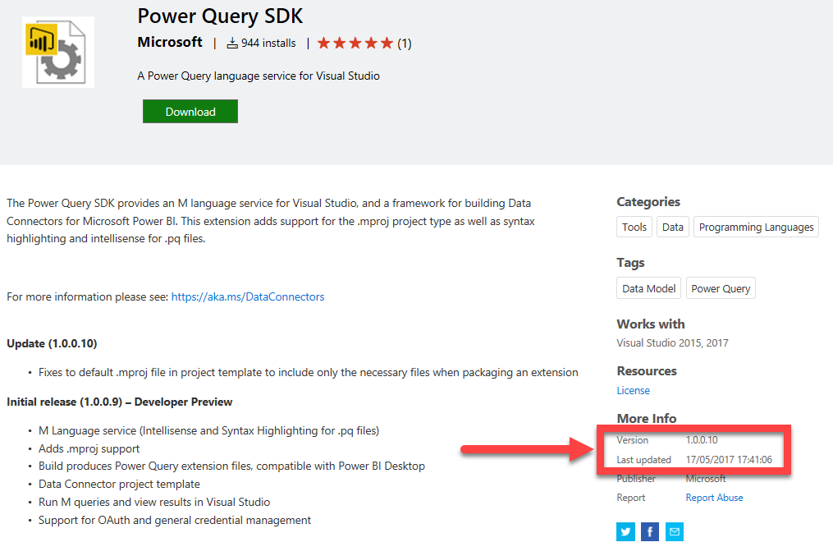
Power Query editor
“Advanced editor”
Notepad++
Visual Studio and Power Query SDK

Slide 16

The secret of being boring is to say everything
Voltaire

Slide 17

Demo (live coding)
Create a list with 5000 elements from 1 to 5000
Create a record by adding a second field with random value
How-to
Each keyword
Persistence of evaluation

Slide 18
Agenda
How to be boring …
Decode the fun with the html characters
Error handling … keep smiling!
“Do something while” does not exist
Doing the L(augh) of ETL (no kidding)
Metadata freedom !!!

Slide 19
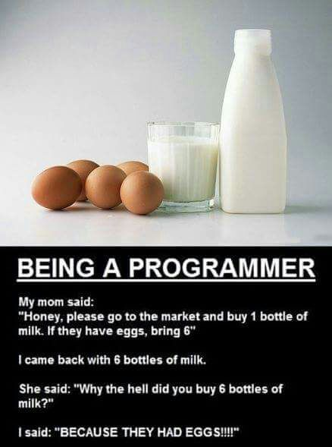
If … then … else
Select between two expressions
Based on a logical condition
else is not facultative
But you can explicitly inform that this path is not implemented by using an ellipsis (…)
if a<b then a+2 else …

Slide 20
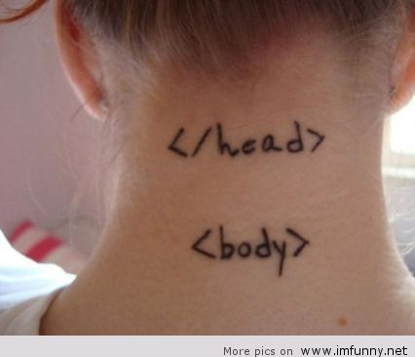
Demo: parse some html characters
Encoded with pattern &#number;
First iteration:
Only 1 special char by word
No error
Expl:
C&#233;dric is translated to Cédric

Slide 21

Agenda
How to be boring …
Decode the fun with the html characters
Error handling … keep smiling!
“Do something while” does not exist
Doing the L(augh) of ETL (no kidding)
Metadata, freedom !!!
I’ll introduce you to the Power Query M language.
But first take a minute to say goodbye to your friends and family!

Slide 22
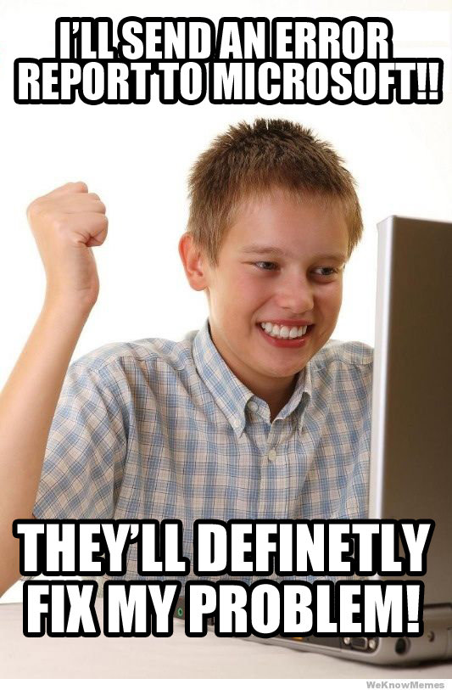
Handling errors
Functions can return errors
0/0
Use try … otherwise … to handle them
You can create your own errors with error “my message”
And check them with x[HasError] and x[Error]

Slide 23

A challenge
Parse movie title and extract production’s year
The Shawshank Redemption (1994)
My Dad Says (2010) {Dog Ed (#1.7)}
Years Younger (2004/I)
abcd(19xy) hqskj dhq (2020)
fdsdf (1995) sdfsdf (19)

Slide 24
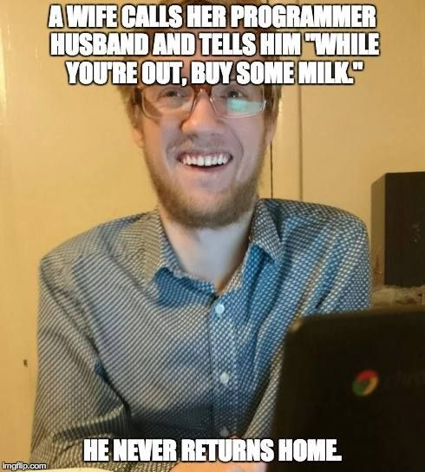
Agenda
How to be boring …
Decode the fun with the html characters
Error handling … keep smiling!
“Do something while” does not exist
Doing the L(augh) of ETL (no kidding)
Metadata freedom !!!

Slide 25
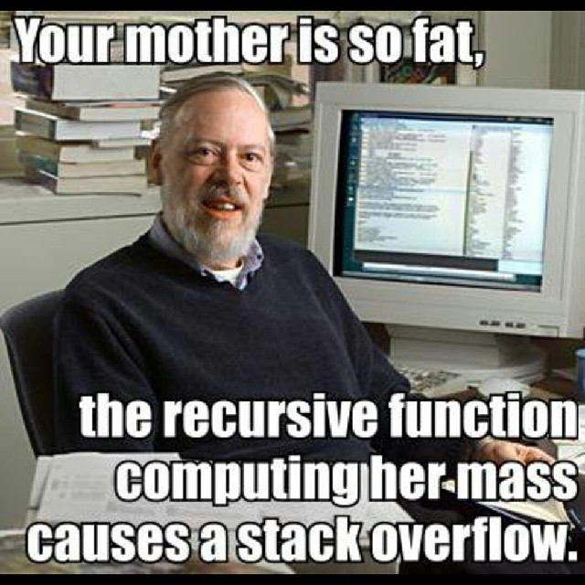
Recursive function
Scoping operator “@” (arrobas)
[
Factorial = (x) =>
if x = 0
then 1
else x * @Factorial(x - 1),
Result = Factorial(3) // 6
]

Slide 26
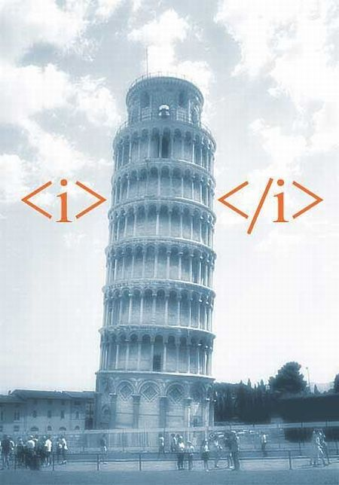
Demo: back to the html characters
Encoded with pattern &#number;
Second iteration:
None or many special chars in a word
Expl:
H&#233;l&#232;ne is translated to Hélène
Alice is translated to Alice
Cl&#233;mence is translated to Clémence

Slide 27
Agenda
How to be boring …
Decode the fun with the html characters
Error handling … keep smiling!
“Do something while” does not exist
Doing the L(augh) of ETL (no kidding)
Metadata freedom !!!

Slide 28
Using data source access
Standard library includes methods to access data sources
Sql.Database lets you run a query on a database
Usually it’s a SELECT but could be INSERT or UPDATE

Slide 29
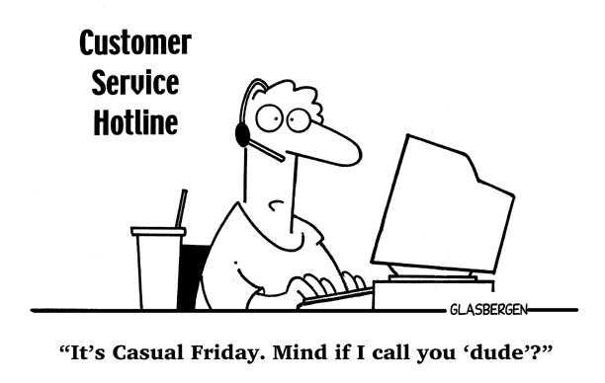
Demo
Manage customers:
Update “Age”
Insert new customers

Slide 30
Agenda
How to be boring …
Decode the fun with the html characters
Error handling … keep smiling!
“Do something while” does not exist
Doing the L(augh) of ETL (no kidding)
Metadata, freedom !!!

Slide 31
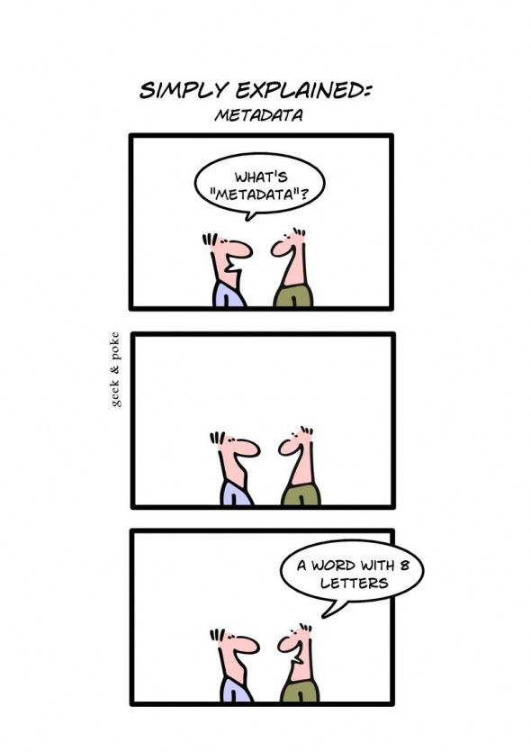
Metadata
Information associated to a value
Presented as a record
Assign
"Mozart" meta [
Rating = 5,
Tags = {"Classical"}
]
Retrieve
Value.Metadata( "Mozart" )

Slide 32
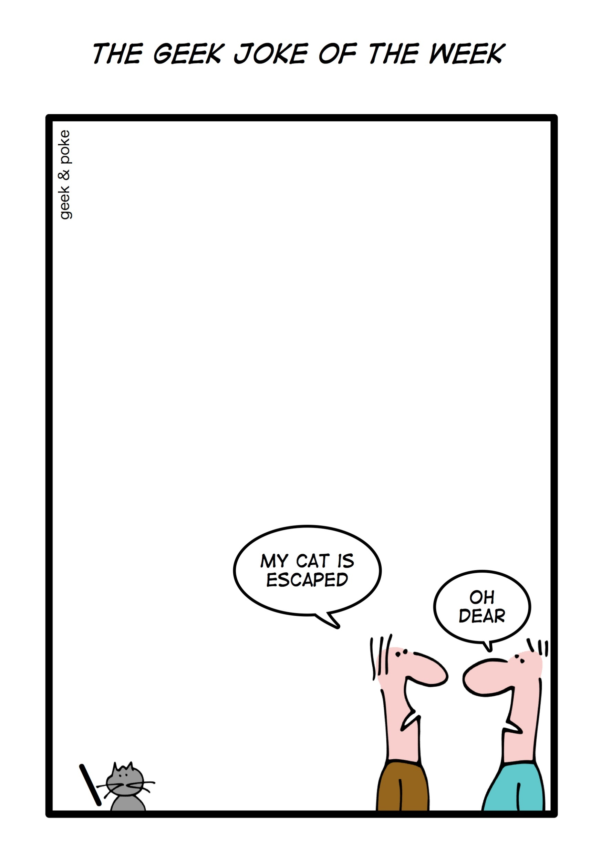
Demo
Retrieve content of a website
Handling not existing/available website

Slide 33

Don‘t forget ... After-Show-Party!!!
5 Jahre SQL Saturday
an der Hochschule Bonn-Rhein-Sieg
SQLSat Bruzzler - Grillparty
Würstchen & Bier ab ca. 19.00 Uhr
am Ende der Hochschulstraße

Slide 34
Sponsors
You Rock! Sponsor
Gold Sponsor
Silver Sponsor
Bronze Sponsor

